Slide 1


TASK 1: HR DATA ANALYSIS
DATA ANALYST INTERNSHIP
BY VAISHNAVI KOMKAR

Slide 2
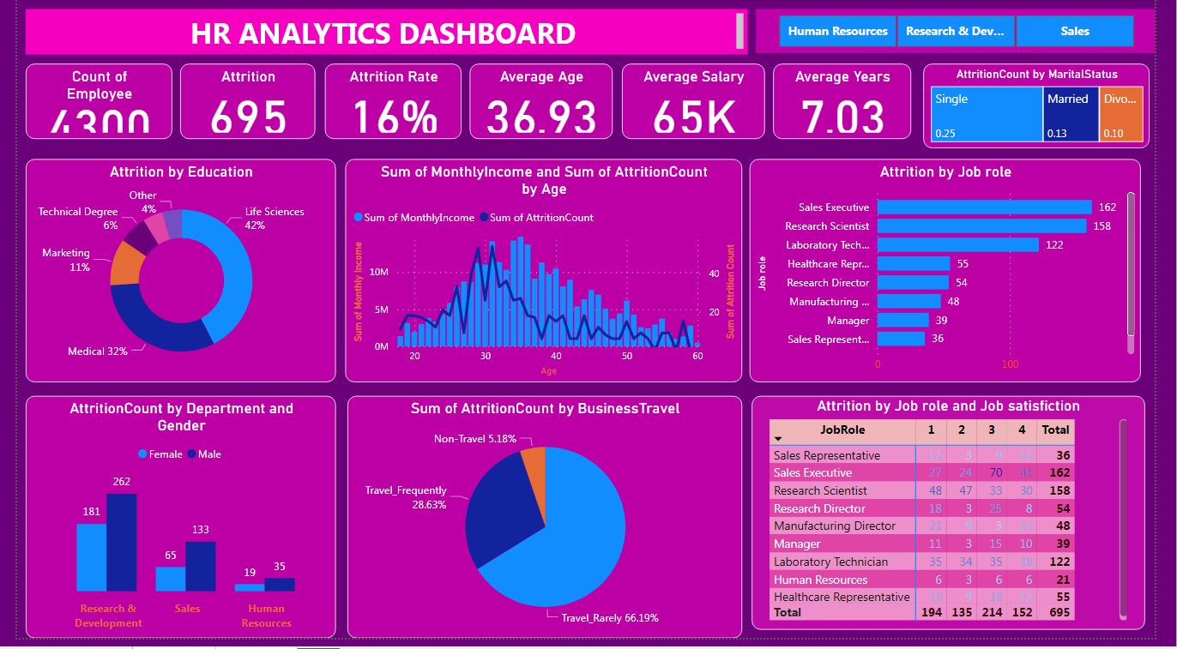
HR Dashboard

Slide 3
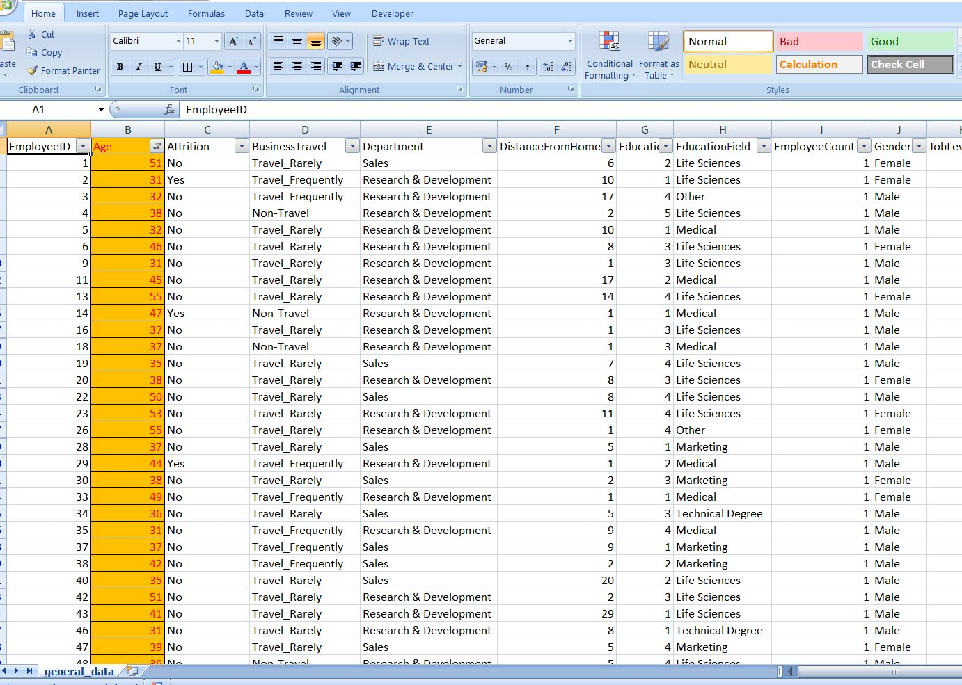
1.Using Excel, how would you filter the dataset to only show employees aged 30 and above?

Slide 4
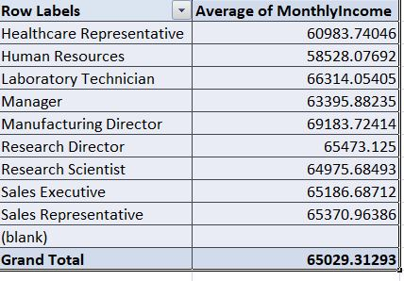
2. Create a pivot table to summarize the average Monthly Income by Job Role

Slide 5
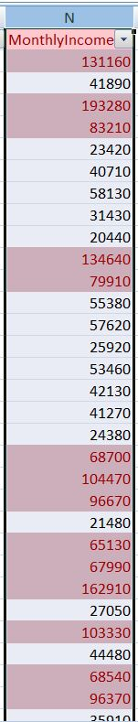
3. Apply conditional formatting to highlight employees with Monthly Income above the company's average income.
Ans: The Average of monthly income is 65026.58

Slide 6
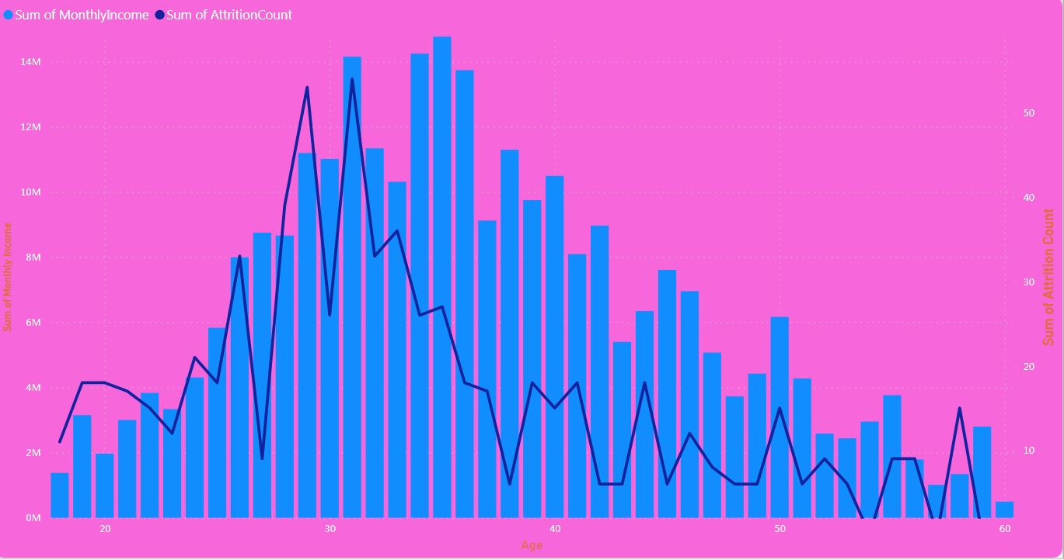
4. Create a bar chart in Excel to visualize the distribution of employee ages.
Monthly income
Attrition count
Employee ages

Slide 7
5. Identify and clean any missing or inconsistent data in the "Department" column.
Ans: There is no missing or inconsistent data in Department column.

Slide 8
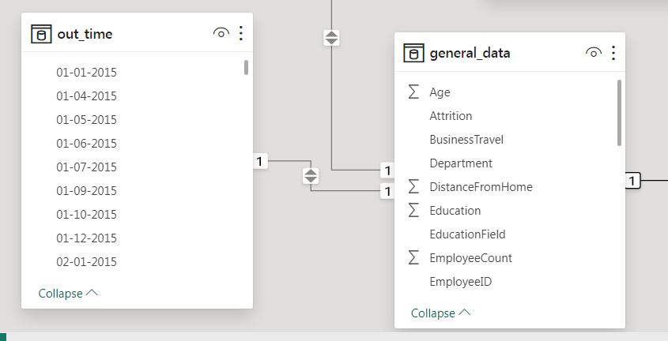
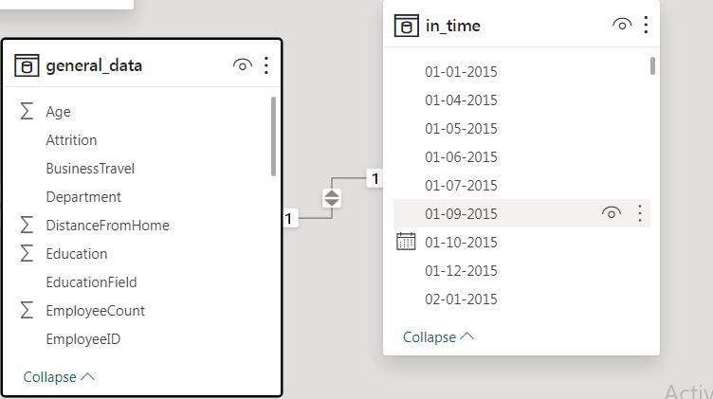
6. In Power BI, establish a relationship between the "EmployeeID" in the employee data and the "EmployeeID" in the time tracking data.
Ans: There is one to one relation between them

Slide 9
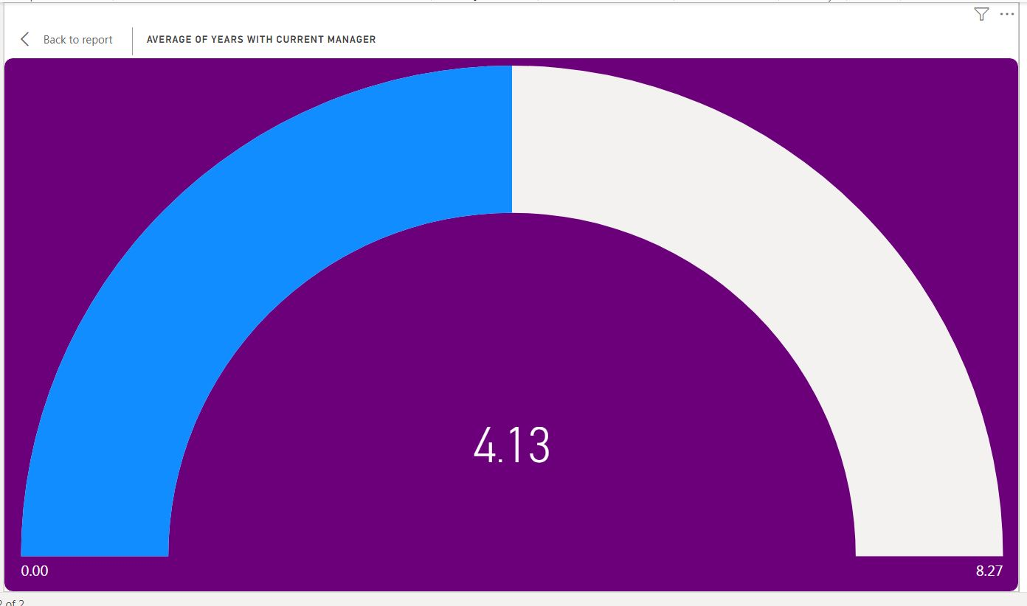
7. Using DAX, create a calculated column that calculates the average years an employee has spent with their current manager
Ans: The average years an employee has spent with their current manager is : 4.13 years

Slide 10
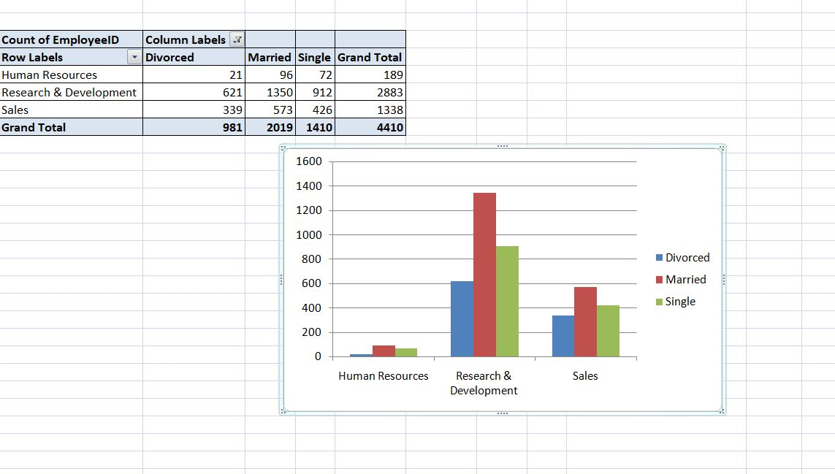
8. Using Excel, create a pivot table that displays the count of employees in each Marital Status category, segmented by Department.

Slide 11
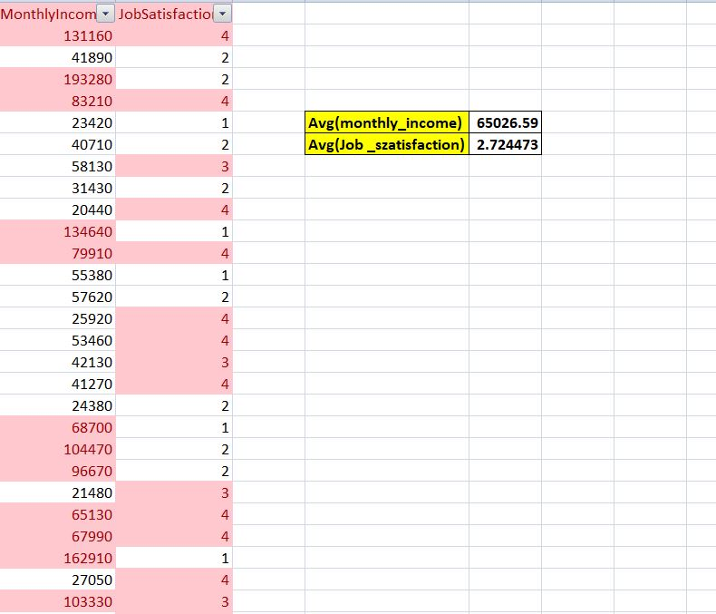
9. Apply conditional formatting to highlight employees with both above-average Monthly Income and above-average Job Satisfaction

Slide 12
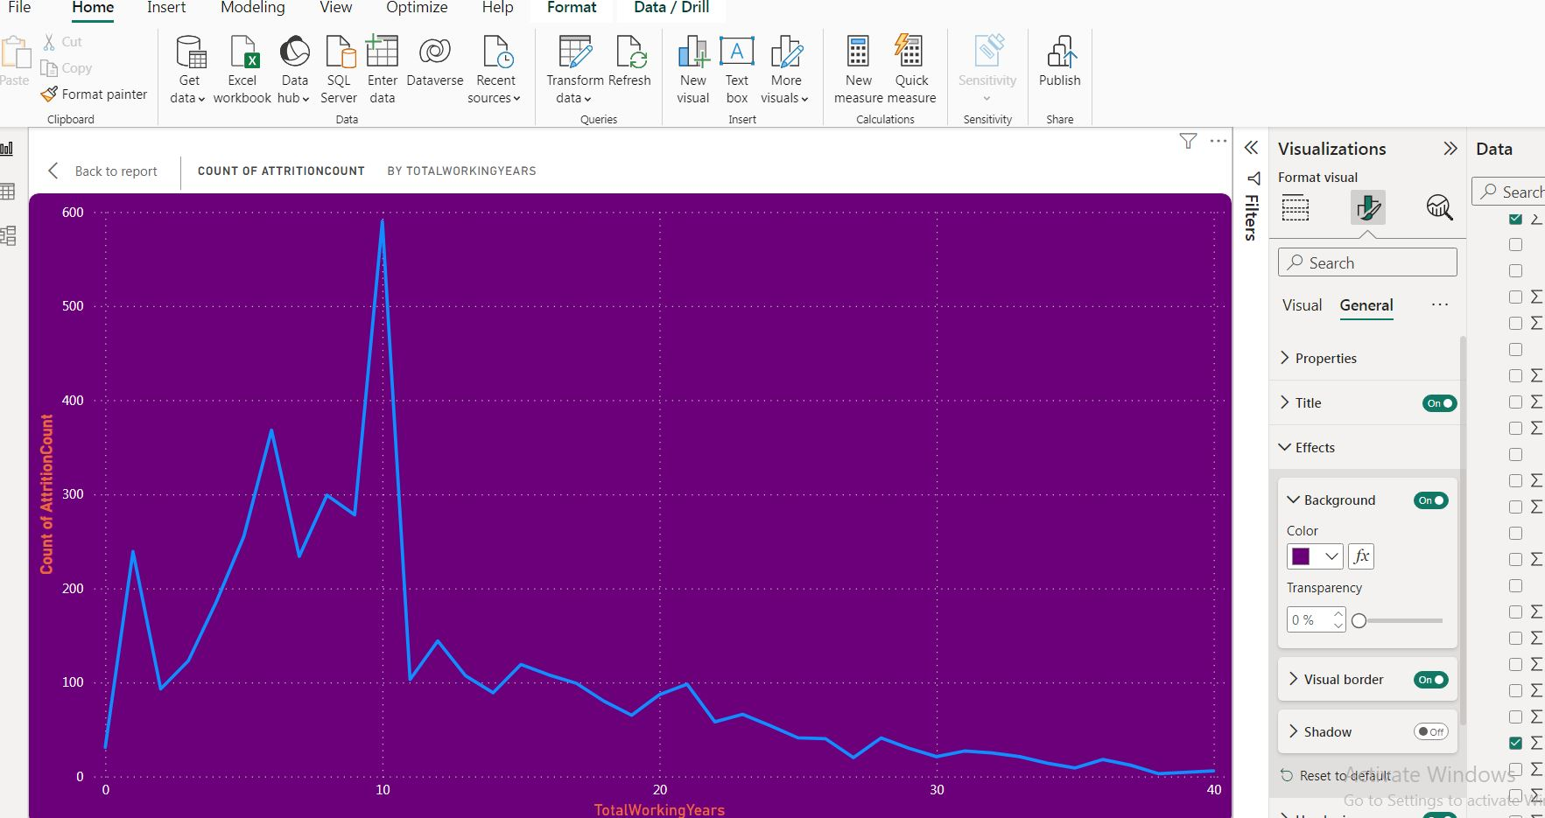
10.In Power BI, create a line chart that visualizes the trend of Employee Attrition over the years.

Slide 13
11. Describe how you would create a star schema for this dataset, explaining the benefits of doing so.
Ans :
To create a star schema in Power BI:
Load Data: Import your HR data into Power BI.
Create Tables: In the ‘Data’ view, create tables for your fact and dimension tables. The fact table could be something like Employee_Salary with fields such as Employee_ID, Date_ID, Salary, Bonus, etc. Dimension tables might include Employee, Date, Department, Job_Role, etc.
Establish Relationships: In the ‘Model’ view, create relationships between your tables. Connect the primary key of each dimension table to the corresponding foreign key in the fact table.
Benefits of using a star schema in Power BI:
Improved Performance: The star schema can improve the performance of your Power BI reports by reducing the complexity of the relationships between tables.
Simplified Model: The star schema simplifies the data model, making it easier for end users to understand and use.
Enhanced Aggregation Capabilities: The star schema enhances the aggregation capabilities of Power BI, making it easier to perform calculations across multiple dimensions.
Remember, the design of your star schema can greatly affect the performance and usability of your Power BI reports, so it’s worth investing the time to get it right. For more detailed information, you can refer to Microsoft’s resources or other online tutorials on this topic.

Slide 14
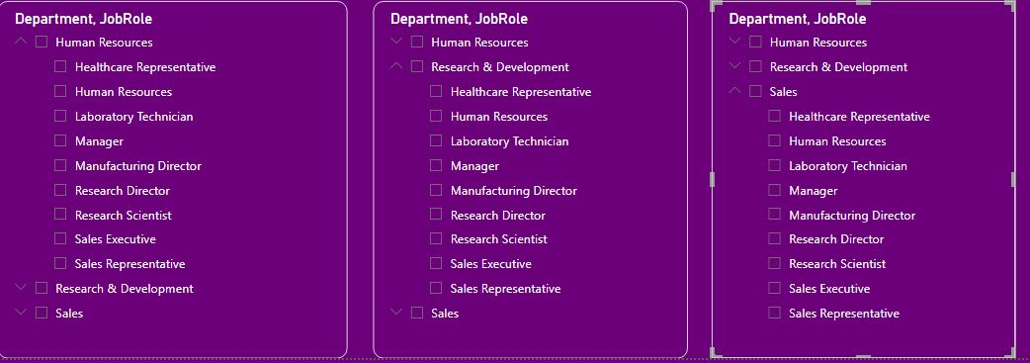
13. Create a hierarchy in Power BI that allows users to drill down from Department to Job Role to further narrow their analysis
Ans:

Slide 15
12. Using DAX, calculate the rolling 3-month average of Monthly Income for each employee.
ANS: To calculate the rolling 3-month average of Monthly Income for each employee in Power BI using DAX, you can use a formula like this:
Rolling_3_Month_Average =
VAR CurrentDate = MAX('Table'[Date])
RETURN CALCULATE(
AVERAGE('Table'[Monthly Income]),
FILTER(
ALL('Table'),
'Table'[Date] >= DATEADD(CurrentDate, -3, MONTH) &&
'Table'[Date] <= CurrentDate &&
'Table'[Employee_ID] = EARLIER('Table'[Employee_ID])
)
)
In this formula :
CurrentDate is the latest date in your data.
AVERAGE('Table'[Monthly Income]) calculates the average monthly income.
Filter function create a new table that include only a row where the date is within the last 3 months and EmployeeID matches the current row’s EmployeeID.

Slide 16
14. How can you set up parameterized queries in Power BI to allow users to filter data based 2 of 2 on the Distance from Home column?
Ans :
To set up parameterized queries in Power BI to allow users to filter data based on the ‘Distance from Home’ column, you can follow these steps:
Create a Parameter: In Power BI Desktop, go to ‘Home’ > ‘Transform data’ > ‘Transform data’ to open the Power Query Editor. Select ‘New Parameters’ under ‘Manage Parameters’ in the ribbon. Fill out the information about the parameter and select 'OK’
Reference the Parameter in the Query: Once you create the parameter, you can reference it in the M query. To modify the M query, open the ‘Advanced editor’ while you have the query selected.
Create a Table of Values: Create a table for the parameter with a column that provides the possible values available to be dynamically set based on filter selection.
Apply Parameterized Filter: Apply the parameterized filter to your table, so data loads only for selected distances from home

Slide 17
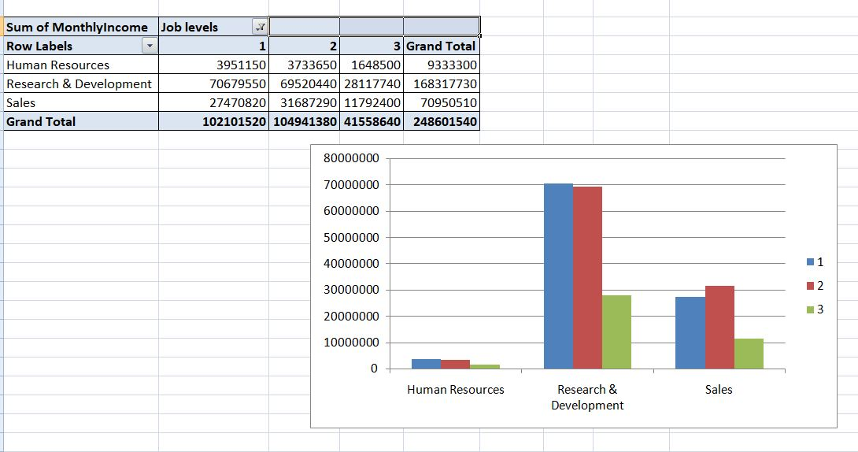
15. In Excel, calculate the total Monthly Income for each Department, considering only the employees with a Job Level greater than or equal to 3

Slide 18
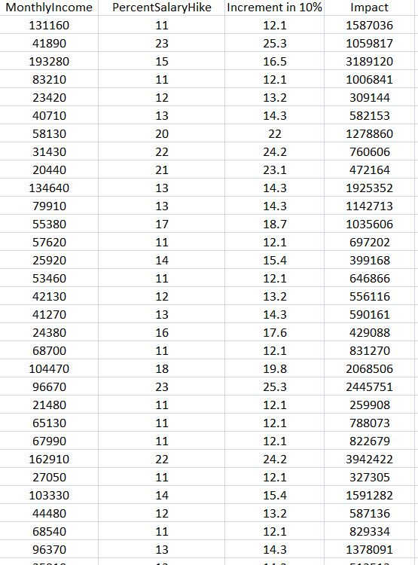
16. Explain how to perform a What-If analysis in Excel to understand the impact of a 10% increase in Percent Salary Hike on Monthly Income.

Slide 19
17. Verify if the data adheres to a predefined schema. What actions would you take if you find inconsistencies?
Ans: If the data adheres to a predefined schema in Power BI and the actions you took upon finding inconsistencies:
Loaded Data: You imported your HR data into Power BI.
Inspected Data: You switched to the ‘Data’ view and inspected each column in your dataset. You checked for inconsistencies in data types, formats, or values that didn’t align with your predefined schema.
Checked Relationships: You went to the ‘Model’ view and verified the relationships between your tables. You ensured that the relationships aligned with your predefined schema.
Assumed Referential Integrity: You used the ‘Assume Referential Integrity’ setting in Power BI to validate that there were no Null or mismatched rows.
Upon finding inconsistencies:
Cleaned Data: You cleaned the data to fix inconsistencies. This involved removing duplicates, filling in missing values, correcting inconsistent formats, etc.
Updated Power Query: You revised the Power Query to fix the inconsistencies.
Communicated with Data Owners: You communicated the issues to the data owners or providers.
Revised Schema: You updated the schema to better reflect the data.
By following these steps, you ensured that your data adhered to its predefined schema, thereby maintaining a high level of data quality for reliable analytics and decision-making.

Slide 20
Overall conclusions

Slide 21
THANK YOU

